Slide 1
A Research Project (IFN702)
Educational Data Mining:
Analyze and Predict student’s academic performance

Slide 2
Acknowledgements
Roles | Name
Author | Zhiying Zhou (9835580)
Academic Supervisor | Dr. Guido Zuccon
Coordinator | Dr. Charles Wang

Slide 3
Contents
1.Introduction:
1.1 Background
1.2 motivation
1.3 Objective
1.4 Deliverables
2.Project Approach :
3.Contributions :
3.1 Immplemention steps
3.2 Project findings
3.3 Implications of the findings

Slide 4
1.Introduction
1.1 Background
This project aims to analyze and predict students’ academic performance. The Mining of students’ interaction performance of education is an emerging field of application of data mining.
Because it may allow to identify early on struggling students with different topics in where students experienced difficulties, or on those students who are more likely to fail in the examination prior to the examination etc.

Slide 5
1.2 Motivation
Examination plays a vital role in any student's life. The marks obtained by students in the examination affect their study and career life, especially in this competitive modern society. Therefore, it becomes essential to predict whether the student will pass or fail in the examination.
If the prediction says that a student tends to fail in the examination prior to the examination then extra efforts can be taken to improve his studies and help him to pass the examination.
Not only will it benefit the students, but also for schools and parents.

Slide 6
1.3 Objectives
We make prediction of students’ academic performance based on the educational datasets.
Identify the which features in this dataset affects the students’ academic performance the most.
The datasets used in this project is just a sample, we can use the same method to analyze all kinds of educational performance to suit all kinds of students in different grade levels, gender, nationality, and even suitable for university student.

Slide 7
1.4 Deliverables
There will be 2 main types of deliverables in this study:
1. A final report
2. One single zip archive folder which contains the following files in this study: Rmarkdown file, Rmarkdown in PDf and HTML format, and the student’s academic performance dataset.

Slide 8
2. Project Approach
Data set:
The dataset consists of 480 student records and 16 features. The features are classified into three major categories:
(1) Demographic features such as gender, grade levels, topic and nationality.
(2) Academic background features such as educational stage, grade Level and section.
(3) Behavioral features such as raised hand on class, opening resources, answering survey by parents, and school satisfaction.
The students are classified into three numerical intervals based on their total grade/mark: Low-Level, Middle-Level, High-Level

Slide 9
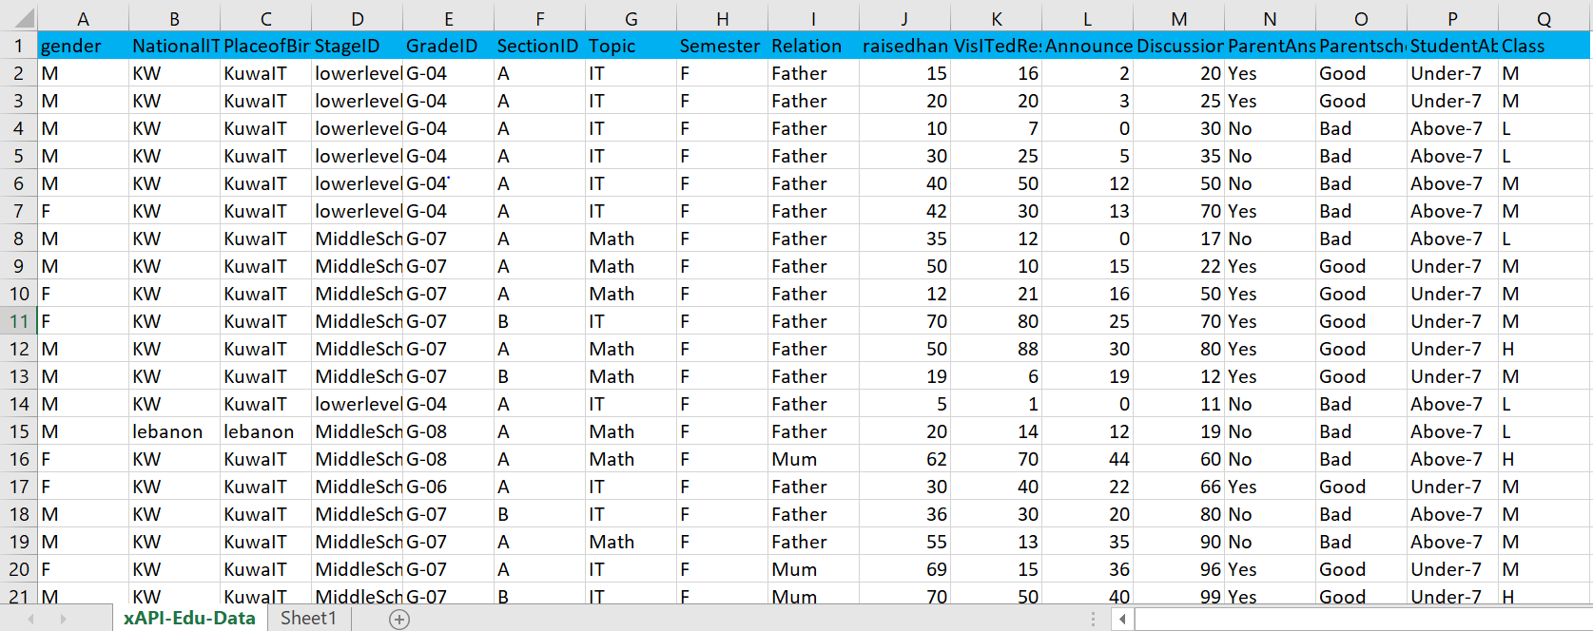
Edu data set: 480 records in total

Slide 10
Main steps of this project:
1. Pre-process of the datasets. Clean the dataset, remove the useless columns or rows; and
2. Explore the datasets. Explore the distribution of the datasets in different features: gender, nationality, grade, topic, parental satisfaction etc. (like girls raises more hand, more discussions in high school etc.); and
3. Find underlying relationships. Like parent who are not satisfied and not answer survey, connection with study activity and performance (raising hand, discussion, absence, parental satisfaction, answering survey etc.); and
4. Build prediction model, like decision tree or regression model to predict the student’s academic performance.
5. Evaluate the predictive results of models and improve the models by comparing the accuracy.

Slide 11
Project management Approach
Project approach
Waterfall software development methodologies are good for small projects that contain clear requirements
1. Planning and Requirements.
2. Design and modeling the project.
3. Follow the plan to develop the R program to analyse and predic the datasets. 4. Test and evaluate the results to ensure the quality of the project.
5. Analyse, evaluate and improvement.
Also make gan chart Project Gantt Chart to manage the project an control risk

Slide 12
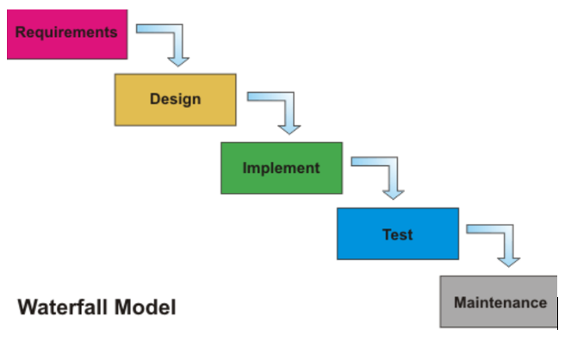

Slide 13
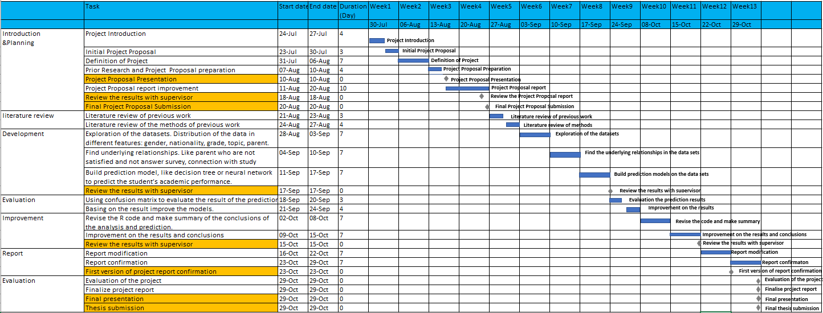
Project Gantt Chart

Slide 14
Project Controlling
Communication Plan
Communication Type | Objective of Communication | Medium | Frequency | Audience | Deliverable
Project progress meeting | Review the progress and improvement for the next week | Meeting | Every week | Academic supervisor | Agenda meeting minutes
Phase Report | Summarize the progress and problems in each phase | Reporting | Phase | Academic supervisor & Project Team | Phased Report
Daily notice | Receive all the mission or seek help from academic supervisor | Communication in Slack | Casual | Academic supervisor & Project Team | Slack communication records
Weekly attendance to Lab | Communication with other student who work on the similar projects | Lab | Every week | Project Team | Lab attendance records
Final | Represent all outcome of this project | Meeting | Final | All stakeholders | Project Report

Slide 15
3.Contributions
3.1 Implementation steps:
Task 1. Exploration of the students' academic performance datasets
Task 1.1. Preprocess the data set: Reorder the "Class"" column, "H","L","M“ => "H","M","L" …
Task 1.2. Bar plots of classification values distribution:
Task 1.3. Histogram of numerical values distribution:
Task 2. Exploration of the relationships between different features of the students' academic performance datasets
Task 3. Build prediction models to predict the students' academic performance, and evaluate the performance
Preprocess: remove some unimportant features.
Prediction model 1 -- Decision tree
Prediction model 2 – Random Forest
Prediction model 3 -- Support Vector Machines
Task 4. Improvement of these prediction models using N-folder cross validation for the prediction models above
Using N-folder cross validation on prediction model 1 -- Decision tree
Using N-folder cross validation on prediction model 2 -- Random Forest
Using N-folder cross validation on prediction model 3 -- Support Vector Machines

Slide 16
3.2 Findings
Main findings of Task 1:
1. Girls have higher rate in high class but lower rate in low class, boys are the opposite. Girls' parents have higher school satisfaction than boys. Boys has higher rate of above 7 absence days. Very few girls in low class.
2. The differences of class performance between place of birth and nationality are very tiny. The findings between pace of birth and nationality are very similar. It’s enough for us to just use nationality instead of both for the next steps.
3. Middle school has the most students. Lower-level has higher rate of above 7 days of student absence. Lower-level has the highest rate of low class students. Highschool has the highest rate of high class students. Middle school has the highest rate of medium class students.
4. Biology has the highest ratio of high class students. It has the highest ratio of low class students. Geology has the highest ratio of medium class students.
5. The students who have moms as guardians have higher chances to get high class marks. Students whose parents answer the survey are the ones getting good marks. Student getting absent are the ones getting low marks.
6. Most of the students with high class have many times of raised hands, visited resource, viewed announcements and discussion, most of the students with low class raised hands, visited resource, viewed announcements and discussed few times.

Slide 17
Main findings of Task 2:
1. It further confirmed our findings in the previous step: Students who have the higher class raised hands, visited resource, viewed announcements and discussed more times.
2. Girls have more hand raises and visit more resources.
3. More raised hands, visited resources and announcements view in middle schools. More discussions in high schools.
4. IT has very few hand raises interestingly although most students study there.
5. Students with Guardians mother, have more hand raises, visited resources and announcements view.
6. Students whose parent answering survey and parents with good satisfaction have more hand raises, visited resources, announcements view and discussion.
7. Students have the more leaves the less raised hands, visited resources, announcements and discussion.

Slide 18
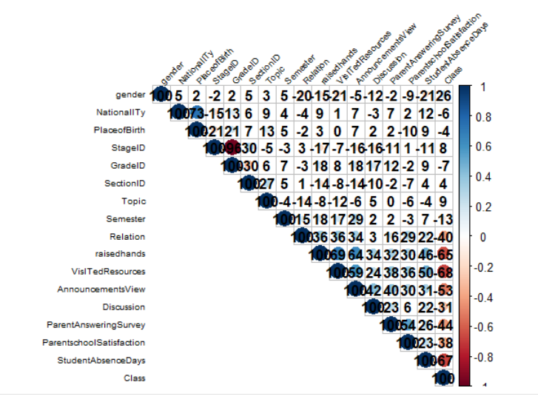
Features correlation plot

Slide 19
Features correlation plot
Important features:
Raisehands
VisitedResources
AnnouncementView
StudentAbsenceDays

Slide 20
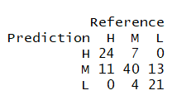
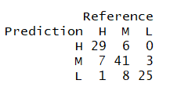
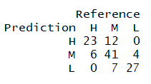
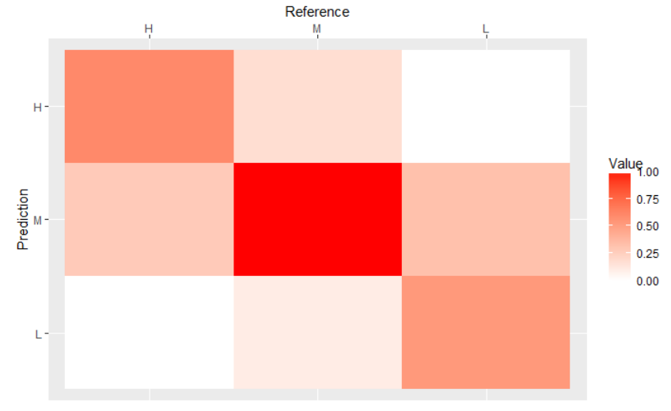
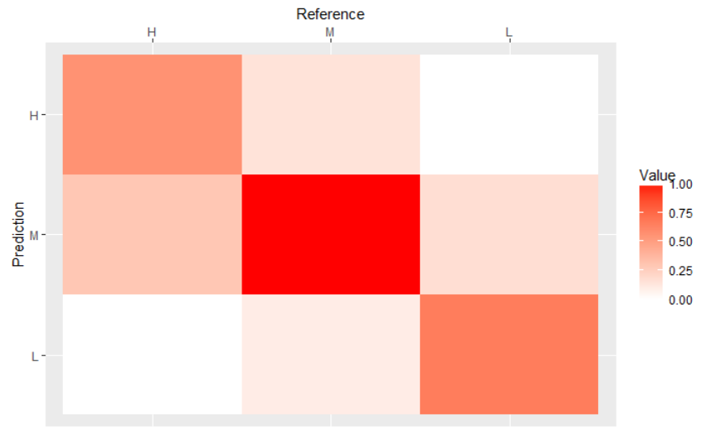
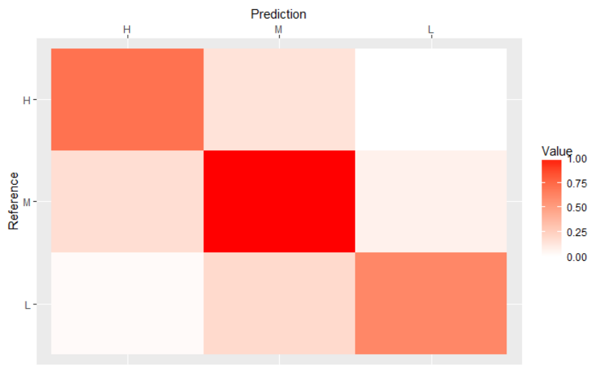
Decision tree Random forest SVM
Comparison of 3 basic models and heat maps

Slide 21
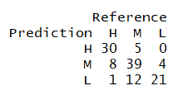
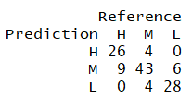
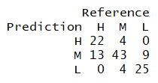
Decision tree Random forest SVM
Comparison of 3 models training on 10-folders cross validation
Basic
10-folder
Cross Validation

Slide 22
Decision tree Random forest SVM
Comparison of 3 models training on 10-folders cross validation
Basic
10-folder
Cross Validation

Slide 23
Decision tree Random forest SVM
Comparison of 3 models training on 10-folders cross validation
Basic
10-folder
Cross Validation

Slide 24
Decision tree Random forest SVM
Comparison of 3 models training on 10-folders cross validation
Basic
10-folder
Cross Validation

Slide 25
Summary of the performance of models
Data set | Models | Accuracy | Mean Precision
Basic dataset | Decision Tree | 0.7083 | 0.8411
 | Random Forest | 0.7583 | 0.8742
 | VSM | 0.7917 | 0.8920
N-folder Cross Validation Data set | Decision Tree | 0.75 | 0.8713
 | Random Forest | 0.8083 | 0.8963
 | VSM | 0.75 | 0.8625

Slide 26
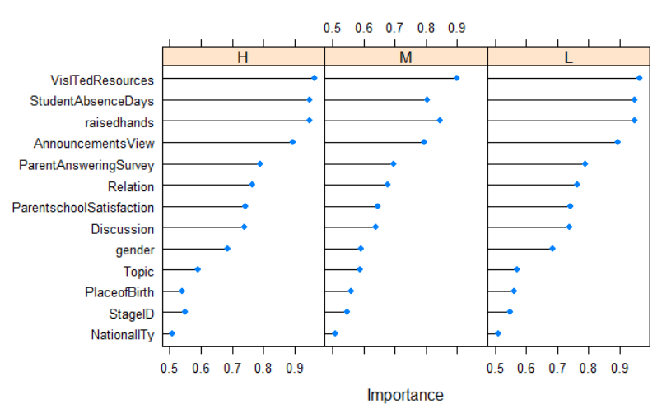
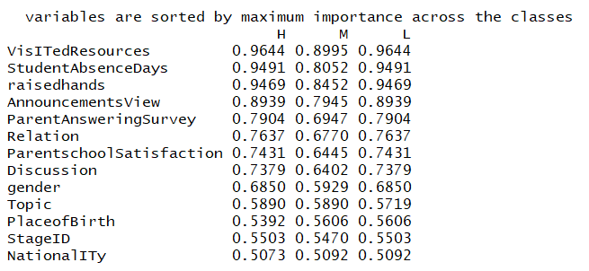
Variable importance plot
1. Decision tree model

Slide 27
Variable importance plot
1. Decision tree model

Slide 28
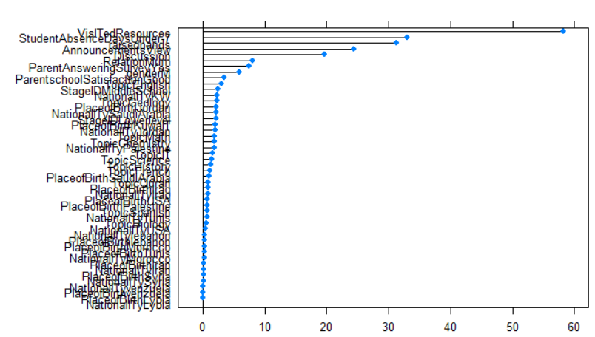
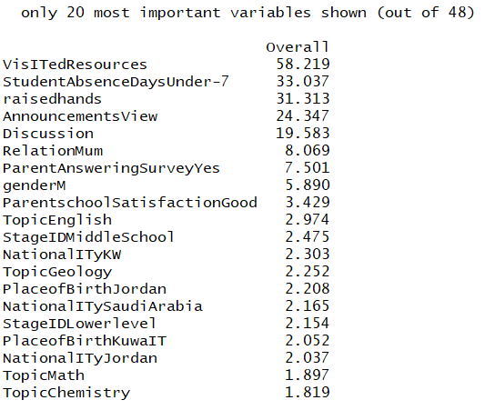
2. Random Forest model

Slide 29
2. Random Forest model

Slide 30
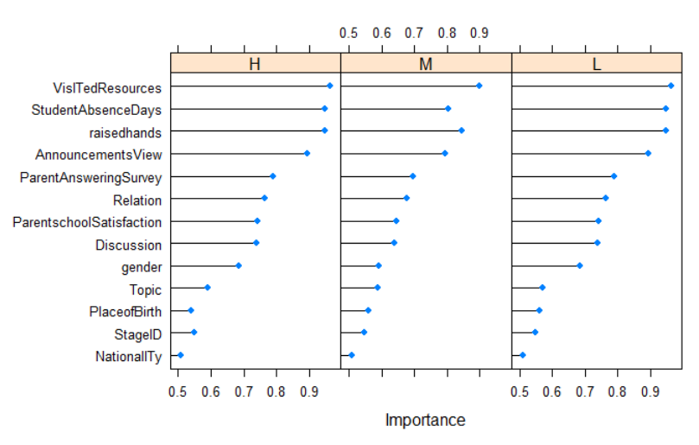
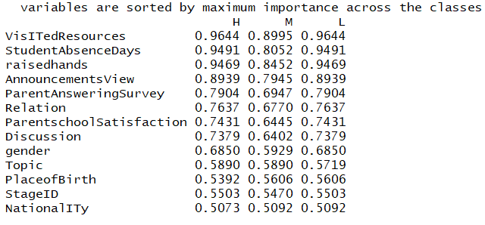
2. SVM model

Slide 31
2. SVM model

Slide 32
Final Conclusion:
1. Decision tree Model and Random forest model performed much better by training on the N-folder cross validation dataset, but SVM model performed even worse than none cross validation.
2. Random forest Model outperformed all the models by training on the N-folder cross validation dataset. It got the highest rate of accuracy and precision. As a result, the random forest prediction model training on N-folder cross validation dataset is recommended for this educational data mining project.
3. The most important activities that related to students' academic performance are VisITedResources, raisedhands, StudentAbsenceDays, AnnouncementsView and Discussion. Then the Relation, ParentAnsweringSurvey, gender and ParentschoolSatisfaction also has some connection with the academic performance. Students' academic performance has little connection with topic, StageID, Nationality, PlaceofBirth, Grade ID, Section ID and semester based on this educational data set.

Slide 33
3.3 Implications of the outcome
Analysis of Educational Data seeks to use these data repositories to better understand students and their study, and to develop computational approaches that combine data and theory to transform practice to benefit students.
This study can facilitate the students and the lecturers to boost the students of all category to perform well. This study helps to spot out those students who require special attention, minimize the failure ratio and to take acceptable action for upcoming semester examination.
In future, prediction models can be experimented on the different kinds of datasets.

